Slide 1
COPADS
IFEOLUWATAYO IGE
#3b – C# and Threads

Slide 2
Outline
Lifecyle of a thread in C#
Thread Creation
Passing arguments via new threads
Interupts () method
Foreground and background threads
Thread pools
Task Parallel library

Slide 3
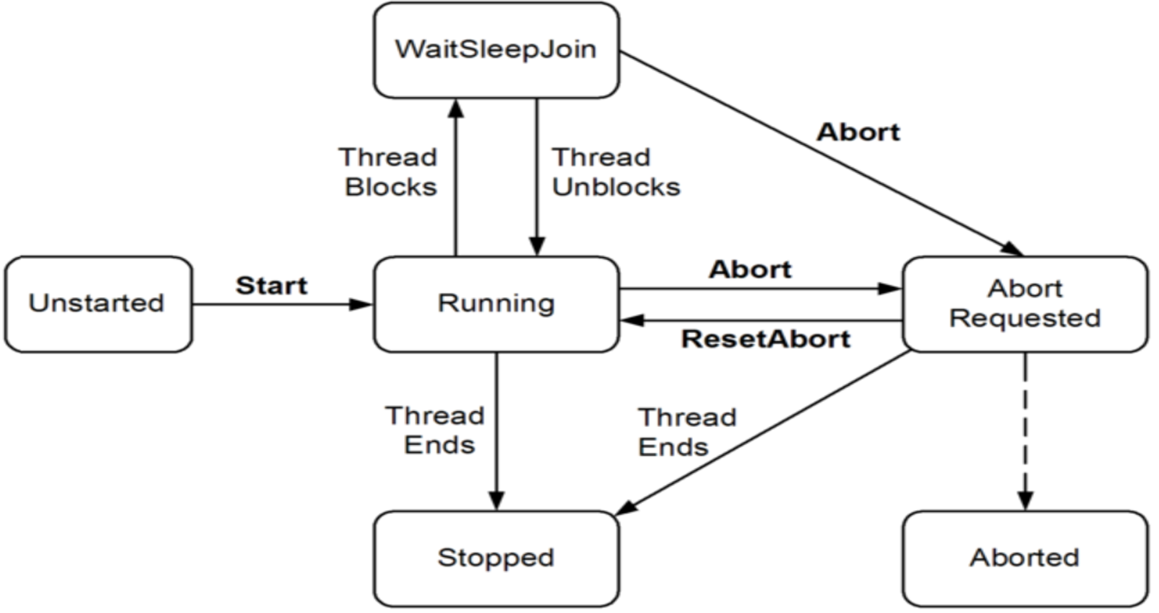
Life Cycle of a Thread in C#
https://learn.microsoft.com/en-us/dotnet/api/system.threading.threadstate?view=net-8.0&redirectedfrom=MSDN

Slide 4
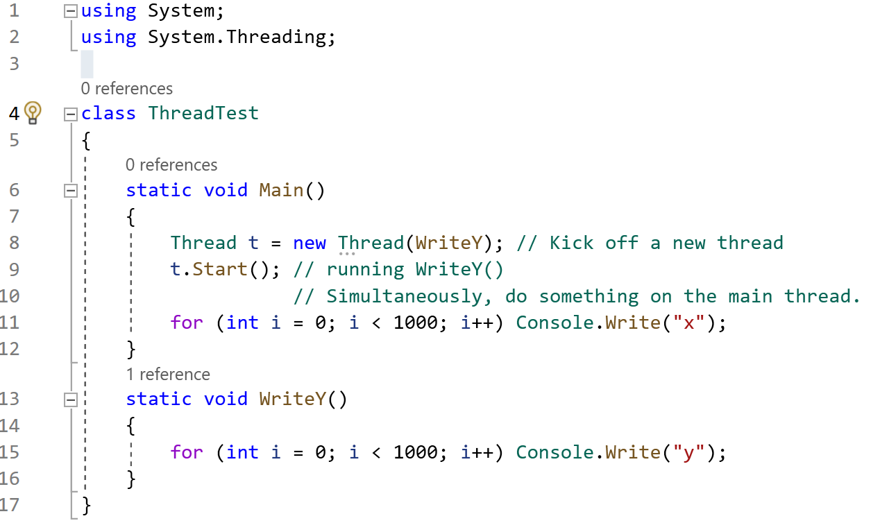
Thread Creation(Example 1)
The namespace ‘System. Threading’ should be imported when working with threads.

Slide 5
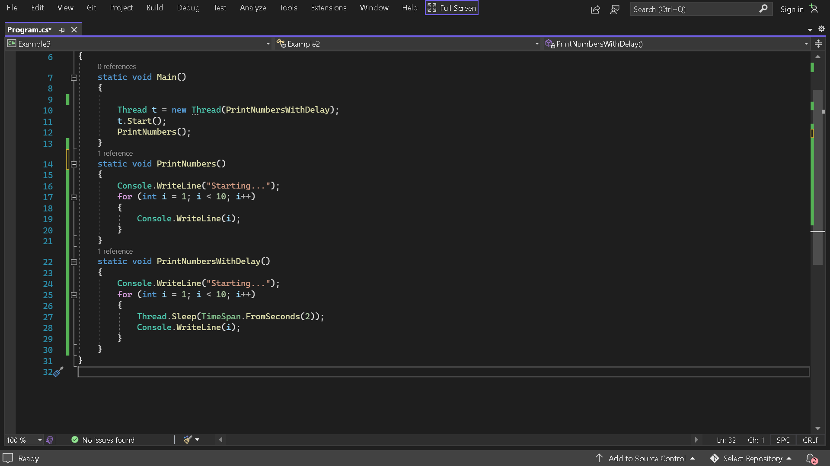
Pausing Threads: Sleep (Example 2)
Thread. sleep() interacts with the thread scheduler to put the current thread in a waiting state for a specified time. Once the wait time is over, the thread state is scheduled to run.
The code in the PrintNumbers will be executed before the code in the PrintNumbersWithDelay method in a separate thread.

Slide 6
Threads: Passing arguments
We can pass arguments to a new thread’s target method by executing a lambda expression that calls the method with the desired arguments:

Slide 7
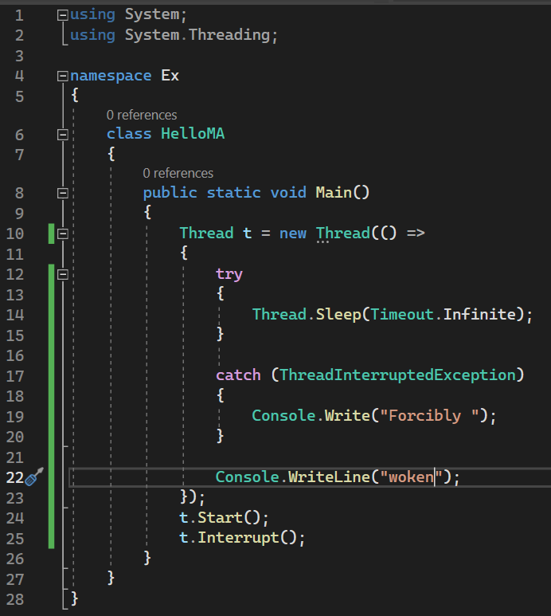
Thread.Interrupts()
In C#, “Thread. Interrupt()” is used for waking sleeping threads.
See example
If Interrupt() is called on a thread that’s not sleeping, the thread continues executing until it gets blocked next, at which point a ThreadInterruptedException is thrown which wakes up the thread.
This is different from OS-based interrupts which may be due to system calls, or preemption.

Slide 8
Foreground and Background Threads
All threads generated by starting a new Thread object are by default foreground threads.
A thread can either be a background thread or a foreground thread.
A foreground thread keeps on running till completion even if the Main thread completes execution or is terminated.
can be created by calling the “Thread. Start()” method.
See Example 3: The life of thr thread doesn’t depend upon the life of the main thread.
Background threads are identical to foreground threads with one exception: a background thread does not keep the managed execution environment running.
As soon as all foreground threads are stopped/aborted in a managed process, the system aborts all background threads.
The Thread.IsBackground property is used to determine whether a thread is a background or a foreground thread or to change its status.
A thread can be changed to a background thread at any time by setting its IsBackground property to true.
See Example 4
https://learn.microsoft.com/en-us/dotnet/standard/threading/foreground-and-background-threads

Slide 9
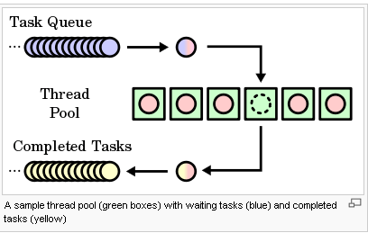
THREAD POOLS
When a thread is created, some seconds are spent to create some private local variables, stack, etc
Each thread consumes (by default) around 1 MB of memory.
Instead of creating new threads, why not have a thread pool and assign tasks to available threads from a thread pool?
A Task represents an asynchronous instruction that likely returns a result.
We should never have to create a new thread every time we need to execute a “task” because thread initialization and disposal are expensive activities for the OS
The thread pool cuts these overheads by sharing and recycling threads, allowing multithreading to be applied at a very granular level without a performance penalty.
The Thread pool consists of Worker threads waiting for task allocation to improve concurrent allocation
Free threads in the thread pool are assigned tasks from the task queue.

Slide 10
When the application starts, the thread pool contains no threads.
Threads are created on-demand only when the application needs them.
After the thread completes, it is not destroyed, unless it remains inactive for too long.
Instead, it returns to the thread pool in a suspended state and is awakened whenever necessary.
Thread pools are typically used for independent short-duration tasks.
All threads in a thread pool are background threads.
Pros of this approach:
No creation or disposal overhead as work is assigned to existing threads
It limits the number of threads that can be created so that the system is not overloaded with many running threads.
When should we create new Threads instead of assigning Tasks to Worker Threads:
When we need a foreground execution of some code.
When we want a thread to have some priority.

Slide 11
Task Parallel Library
The .NET framework provides a “System. Threading. Tasks” class in the Task Parallel Library (or TPL), for creating tasks and running them asynchronously
A task will by default use the Threadpool when created.
Parallel.For and Parallel.ForEach are iterative methods in the System.Threading.Tasks namespace.
A standard for loop in C# iterates over a block of code and this execution of the code is always done sequentially.
Let’s say we want to print the numbers from 1 to 10 sequentially
See Example 5
The output will be 1 to 10 in sequential order.
Parallel. For loop, however, executes iterations that may run in parallel. It allows the iterations to run in parallel across multiple threads.
With the standard for loop, we can predict the order in which the numbers would appear on the console, but with Parallel For loop, we cannot do that.
Parallel.For(<start>, <end>, <item>=>{anonymous method})
See Example 6

Slide 12
Iteration: Parallel.ForEach
Parallel.Foreach is also a method in the System.Threading.Tasks namespace
Foreach loops through a collection, processing a single item sequentially while using a single thread.
It does not require an index or a counter variable.
It however cannot be used to iterate over a collection in reverse order since it does not provide access to the current item's index.
The Parallel. ForEach loop partitions the source collection and schedules all the tasks on multiple threads to run in parallel based on the system environment.
Parallel.ForEach(<collection>, <item>=>{anonymous method})
Parallel. ForEach’s execution is faster than foreach in most cases? True or False?
See Example 7
The cost of splitting up work amongst different threads needs to be tiny compared to the amount of work done per thread.

